Slide 1
English Week 9
Stage 3

Slide 2
Wednesday
Complete grammar worksheet on homographs (15mins).
Complete writing BTN- ‘A moment in time’ activity (40mins)
Write out spelling words (5mins)

Slide 3
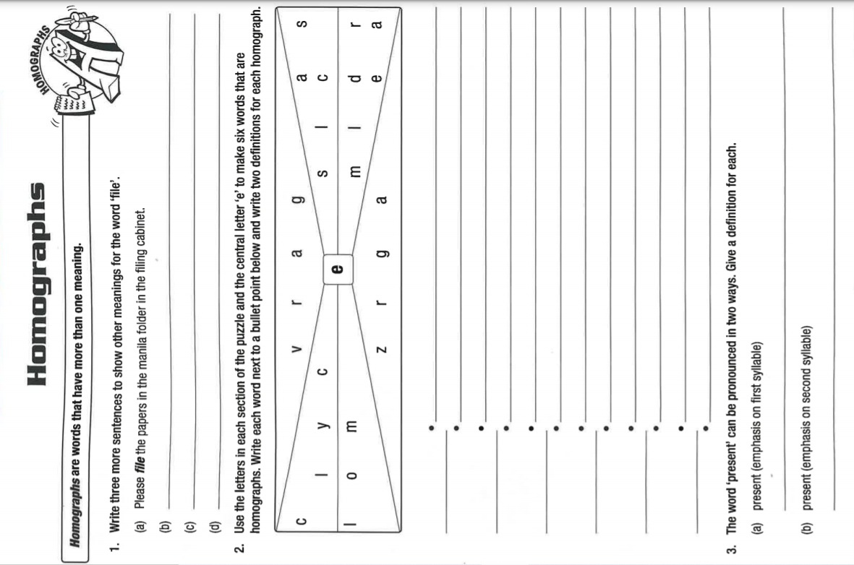

Grammar
Complete the worksheet on homographs.
Use a dictionary to check meaning before writing sentences.
1 star- complete questions 1.
2 star- complete questions 1 and 2.
3 star- complete all questions

Slide 4

BTN
1 star- Complete I heard and I saw.
2 star- Complete I heard, I saw and I felt.
3 star- Complete I heard, I saw, I felt and I wondered with additional detail.
Students watch this weeks BTN episode: https://www.abc.net.au/btn/classroom/20210831-ep25-btn/13513822
Complete ‘A moment in Time Activity’ (20mins)
After watching the BTN episode select a story you are going to write about (not the Fast Fashion story).
Complete the template like the one on the next slide using only a sentence or two for each section.

Slide 5
Example of ‘A moment in time’ activity:
A moment in time- ‘Paralympics- We the 15’
I heard… | The voices of countless passionate individuals wanting to be considered equals.
I saw… | The bike accelerate past as it made its way around the track.
I felt… | I felt the splash of the water as the swimmer dove into the pool.
I wondered… | How can each person make a change in their life to ensure that people with disabilities feel included in everything?

Slide 6
A moment in time-
I heard…
I saw…
I felt…
I wondered…

