Slide 1
Wednesday week 9 Maths
Multiplication and Division

Slide 2


Learning intention:
I am learning to select and apply appropriate strategies for multiplication and division.

Slide 3
Set up of week 9 Math's
Hi Stage 3, we have tried to set up your math's work this week a little differently.
You will notice each slide has a star
Just like at school, sometimes we need to complete work differently to other students to make sure we are working on a skill that will help you to continue to learn and grow.
Your teacher will be in contact with you if you are to work on the 1 star or 3 star activities.
If you feel the 2 star activity is too hard, please attempt the 1 star activity. If you feel the 2 star activity is to easy, please try and complete the 3 star activity.

Slide 4
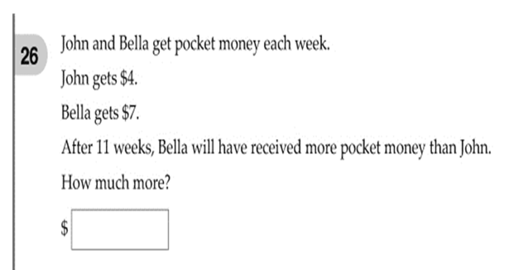
Naplan question:

Slide 5
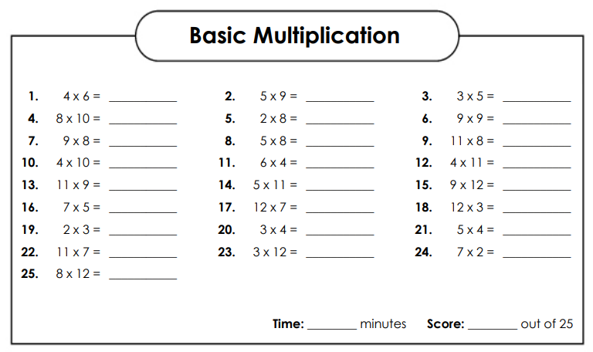
Set your timer for 10 minutes and complete the multiplication fact sheet. See if you can beat your PB (time and score)

Slide 6
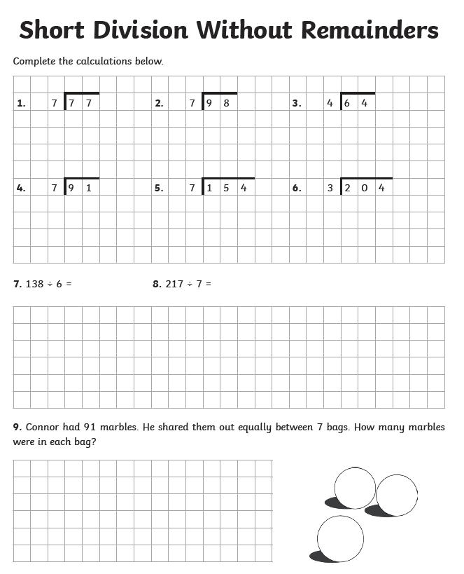
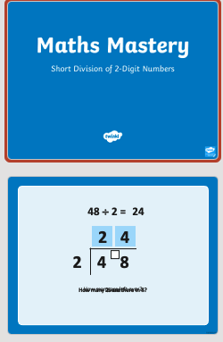
Division
Watch the PowerPoint on short division of 2-digit numbers and then complete the worksheet

Slide 7
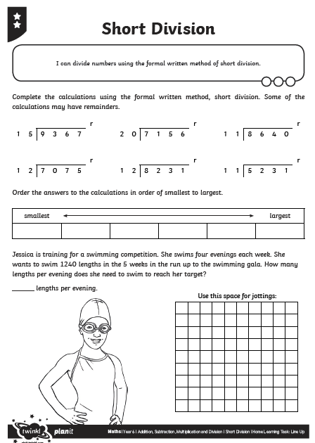
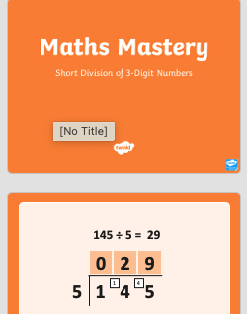
Short division
Watch the PowerPoint on short division of 3-digit numbers and then complete the worksheet

Slide 8
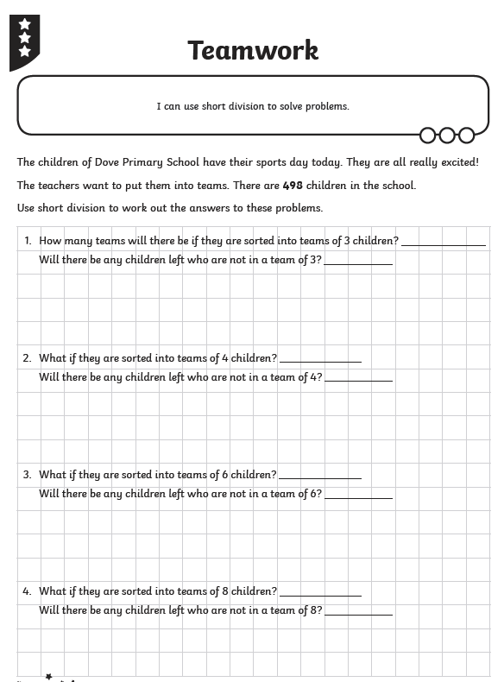
Complete 2 star activities and then solve the attached division word problems.
Short Division- word problems

